Slide 1

Python As An Additional Language
Lesson 5: Getting Modular, getting Classy and talking with JSON

Slide 2
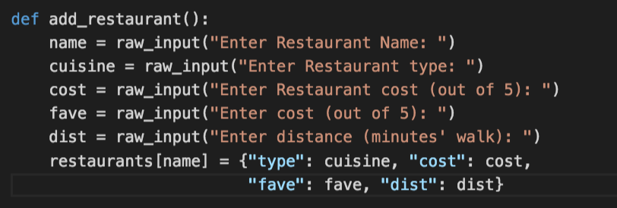

Where are we?
Have a look at http://go/5hciuvsg
How does my solution to last week’s exercises differ from yours?
You might have added some validation. It’s fine if you haven’t.

Slide 3
A modular approach
We might want to write a function and use it across multiple programs
Remember the csv module? Let’s build our own
Download the following files from my git repository http://go/6huik344
Lesson5.py
restaurant_functions.py
Change the CSV file reference to one of your CSV files.
How does this differ from last week’s code?
Run the program. Is there anything new on your hard disk?

Slide 4
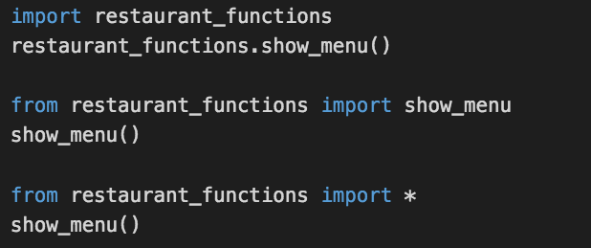
Old slide, new function
We can access functions in a module without referencing the module using from
It’s usually a bad idea to do from module import *

Slide 5
Exercise
Try moving add_restaurant() to the module file

Slide 6
Exercise
Try moving add_restaurant() to the module file
You’ll get an error when you run your program – what is it?

Slide 7
Exercise
Try moving add_restaurant() to the module file
You’ll get an error when you run your program – what is it?
The module is external code and doesn’t know about any of your local variables.
Any ideas what we can do to fix that?

Slide 8
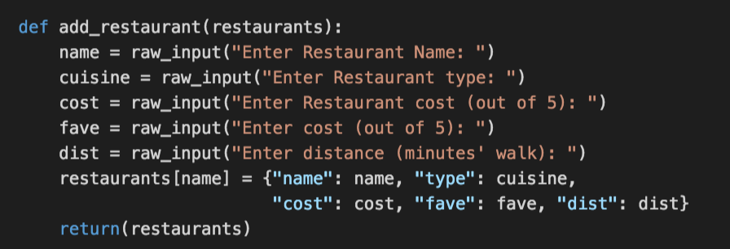
A couple of small changes

Slide 9
Passing the data back and forth
What’s happening here?
More to the point, why am I returning restaurants directly?

Slide 10
http://s2.quickmeme.com/img/72/72ba90745628a5c27e7f844dacdafc9318cf7876b9de9f424cebf0018345e1cc.jpg

Slide 11
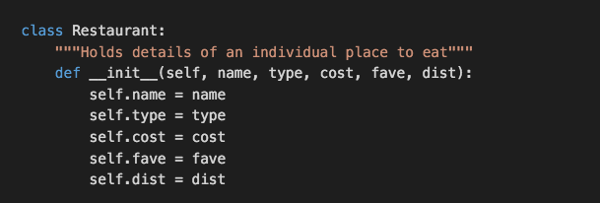
Let’s get Classy
When we start a class, much like a program, we might want to do a few things
What do you think is the meaning of self ?

Slide 12


Let’s get Classy
What will this do?

Slide 13
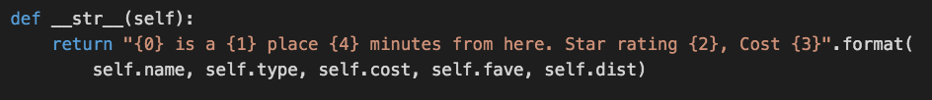

What happened?
When you print, Python tries to render the output as a string
Python doesn’t know how to turn a Restaurant object into a string
Another member method for the Restaurant class:
Does print moro work now?

Slide 14
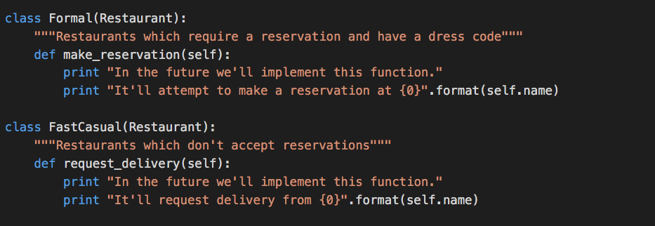
Being more specific

Slide 15
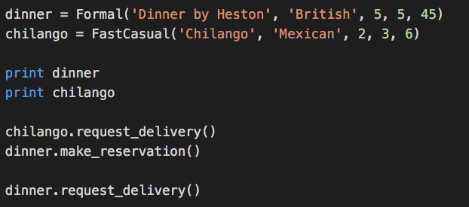
Getting your inheritance

Slide 16
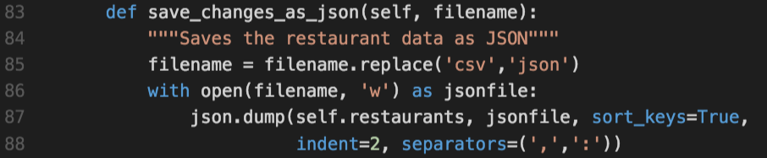
Dealing with JSON: JavaScript Object Notation
Don’t forget to import json
What do the sort_keys, indent and separators arguments do?
Can we leave them out?

Slide 17
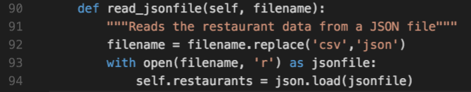
Doing the opposite

Slide 18
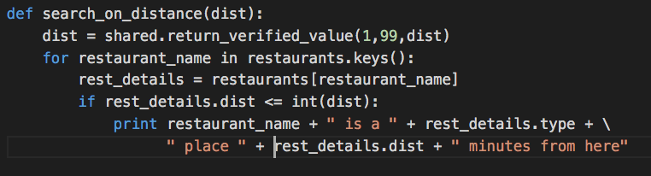
Exercise/Homework…
Update the rest of your program (load, save, search) to use an instance of Restaurant instead of a dictionary
Example:
Questions? Comments? Come see us in S13, on Thursday, 11:00 – 12:00

